Slide 1
Primary Palliative Care Education Serious Illness Communication (Part 1)
Notes:
SLIDES 1-2: 2 MINUTES

Slide 2
Module Objectives
List best practices when communicating with seriously ill patients and families.
Describe four skills to enhance your communication with seriously ill patients and families.

Slide 3
For Reflection What do you already do well in terms of communication?
Notes:
5 MINUTES
Ask the group: “What is the first thing that comes to your mind when you hear palliative care?
Write down responses to be referred to as you progress through the rest of the talk.
What do you already do well in terms of communication?
How does your discipline impact (or not impact) how you view your role in communicating with seriously ill patients and families?

Slide 4
For Reflection How does your discipline impact (or not impact) how you view your role in communicating with seriously ill patients and families?
Notes:
5 MINUTES
Ask the group: “What is the first thing that comes to your mind when you hear palliative care?
Write down responses to be referred to as you progress through the rest of the talk.

Slide 5
Guiding Principles and Practices
Focus on the whole person/family unit
Be receptive to when patient is ready to talk
Listen empathetically
Provide accurate information that is straightforward, understandable, and respects how much a patient/family want to know
Respond to emotion
Notes:
SLIDES 5-14: 23 MINUTES
These guiding principles and practices relate generally to approaching seriously ill patients and families with respect and compassion.

Slide 6
The Good News!
Serious illness communication associated with (Curtis 2013, Detering 2010):
Greater concordance between patients’ wishes and the care they receive
Better patient quality of life
Less use of nonbeneficial life-sustaining treatment; Higher use of hospice care
Less family distress
Self-efficacy has been associated with higher rates of job satisfaction and lower rates of burnout (Emold 2011)
Communication skills can probably be taught (Moore 2018)
This Photo by Unknown Author is licensed under CC BY
Notes:
Notes for “probably can be taught”:
Moore 2013:
Cochrane Review of 15 RCTs for cancer care medical providers including physicians, nurses, residents
Improvement in information gathering and supportive skills (more likely to use open questions in the post-intervention interviews than controls and show empathy towards patients
Note study by Curtis et al where no change in patient perception of quality of communication after 8 days of simulation based training for IM residents

Slide 7
And Some Bad News…
All disciplines lack education and confidence
Emotional cues often missed or not attended to
Clinicians talk too much, patients talk too little
(Anderson 2011, Levinson 2000,
Ury 2003, Wittenberg 2016)
This Photo by Unknown Author is licensed under CC BY
Notes:
Lack education and confidence:
Ury 2005: Survey of 155 interns from 47 US medical schools; Over 40% of the respondents recalled having no formal teaching of how to discuss prognosis, give bad news, or counsel patients’ families. Also found to have limited clinical experience caring for dying patients when entering residency. The majority of respondents rated their comfort levels with giving bad news (77.6%), and discussing advance directives (78.7%) as very low, low, or fair. Many more interns felt comfortable when asked to treat depression or manage hypertension.
Wittenberg 2016: Few APNs have had any formal training in GOC conversations
Emotional Cues Often Missed:
Levinson 2000: Surgeons did not respond to 60% of emotional cues, PCPs did not respond to 80%
Clinicians Talk too much:
Anderson 2011: But sometimes we don’t talk about the right things (or enough). 80 patients admission encounters with attending internist. The median length of the code status discussions was 1 min (range 0.2-8.2). Prognosis was discussed with code status in only one of the encounters. Discussions of patients' preferences focused on the use of life-sustaining interventions as opposed to larger life goals. Descriptions of CPR as an intervention used medical jargon, and the indication for CPR was framed in general, as opposed to patient-specific scenarios.

Slide 8
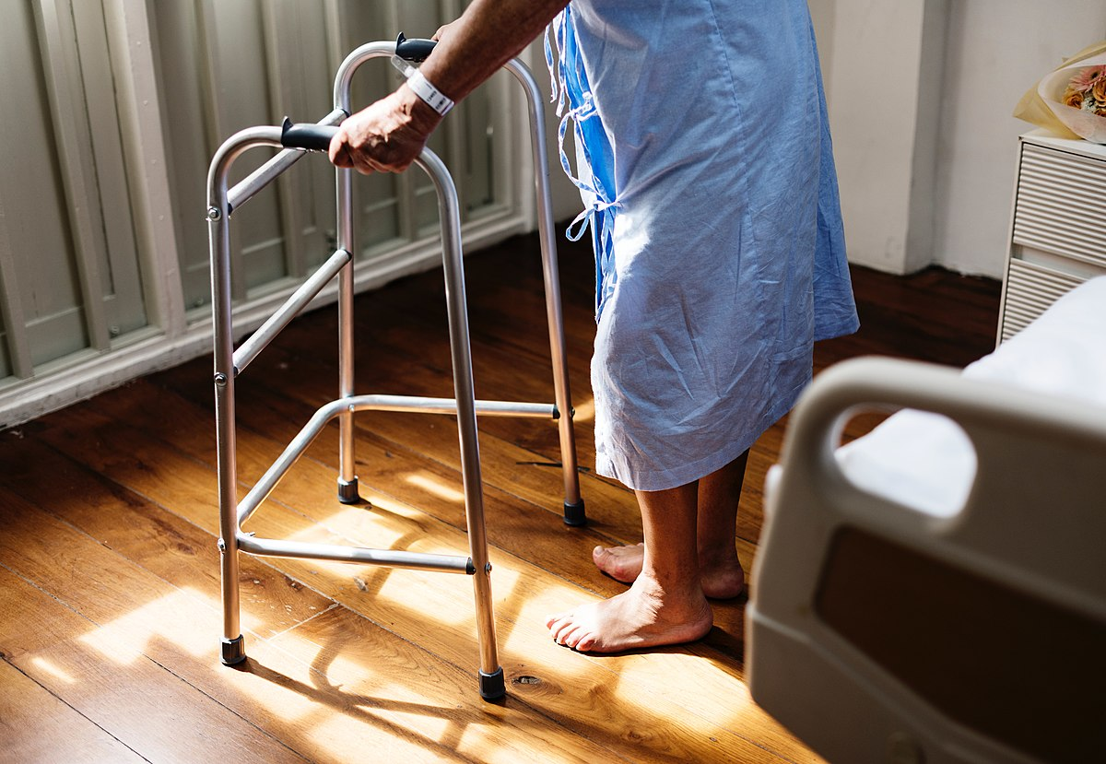
What Most Patients (and Families) Want
Clinicians to bring up EOL issues
Clinicians who are available and willing to talk AND listen
Timely and clear information
Prognostic information
Give bad news sensitively
Encourage questions
Control over the timing of conversation
Being an active participant in decision-making, but want recommendations
(Butow 2002, Gold 2009, Steinhauser 2001, Wenrich 2001)
This Photo by Unknown Author is licensed under CC BY-SA
Notes:
Highlight that every member of IDT can participate in supporting good communication, even when they are not the one giving specific prognostic information or discussing various treatment options. IDT can help clarify and fill gaps in understanding, promote sensitivity with which you approach a patient/family, respond to emotion, and advocate for patients.
Ask: How do you see your role on the team when it comes to communication with patients and families as well as within your medical team?

Slide 9
Four Communication Skills to Master
Asking for Permission
Ask-Tell-Ask
“I wish”
NURSE for Responding to Emotion

Slide 10
Asking for Permission
Example scenarios:
Disclosing a diagnosis
Discussing prognosis
Having a difficult conversation
Understanding what to talk about with whom
“I have some information about your cancer, would you like me to share it with you?”
“Would you like to talk more about the worries you have about your kids?”
Licensed by Creative Commons
Notes:
Gets at what do patients want to know, also gives patients and families a sense of control.
We know that most patients want to know, for instance about prognosis, but they want a sense of control of how much information and timing of the conversation.

Slide 11
Ask-Tell-Ask
The first “Ask” can help you:
Get permission
Understand preferences for receiving information
Assess the pt/family’s current level of understanding (“what has your medical team told you?”) or emotional state
Then, “Tell”:
Present information clearly, in small chunks, no jargon
Then “Ask” again to:
Check for understanding and agreement
Notes:
If you have time you can ask for two volunteers to quickly demonstrate this skill in front of the group.

Slide 12
“I Wish”
Examples:
“I wish we had more effective treatments for your dad’s dementia”
”I wish I had better news to share”
“I wish you could eat twelve cookies before bedtime”
First and foremost an expression of empathy
Acknowledges you are listening
Acknowledges you wish circumstances were different AND the emotional impact of the loss
Avoid adding “but…”
Only say it if you mean it; be prepared for deeper emotion
Licensed by Creative Commons
(Quill 2001)

Slide 13
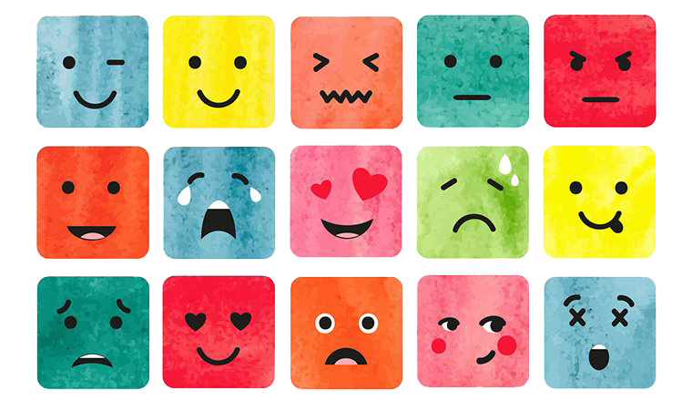
Responding to Emotions
Most patients and families will have some emotional response to discussing topics where difficult information is conveyed
The emotional response may sound like a factual question or statement
“Isn’t there something else you can do?”
“Are you sure we’ve looked into everything?”
“I just don’t understand…”
This Photo by Unknown Author is licensed under CC BY-NC
Notes:
What are some ways people may express emotions and how should we respond?

Slide 14
Name ”It sounds like you are frustrated.”
Understand “I can imagine how scary this is.”
Respect “I can tell you’ve been working hard to manage your heart failure”
Support “Our team will be here for you through this”
Explore ”Tell me more…”
Notes:
The NURSE mneumonic can be helpful as a clinician when responding to emotion.

Slide 15
Video Review
Permission to use IMPACT-ICU video for non-commercial educational purposes granted by Dr. Wendy Anderson
This Photo by Unknown Author is licensed under CC BY-NC
Notes:
15 MINUTES
The video can be found at the link here: https://vimeo.com/215575205 or in the MedEdPortal Module 4 materials as a video file
Ask learners to focus on the four skills they just learned and write down SPECIFIC language used by the nurse and the patient’s husband
4 min video, 6 min video “what skills did you see the nurse using” (encourage learners to cite specific language, questions, phrases used and link to the skills from handout)
Note: IMPACT-ICU videos are allowed to be used for educational, non-commercial purposes per Dr. Wendy Anderson. See copy of email granting permission.

Slide 16
“All medical care flows through the relationship between physician and patient and the spoken word is the most important tool in medicine.”
Eric Cassell, MD
Emeritus Professor of Public Health Weill Medical College of Cornell University
Notes:
SLIDES 16-19: 5 MINUTES

Slide 17
Takeaways
What is one communication skill or technique you learned today that you want to apply to your practice moving forward?
This Photo by Unknown Author is licensed under CC BY
Notes:
Depending on amount of time available, have a few learners share their responses OR go around in a circle and ask everyone to share what they are taking away from the module today.

Slide 18
Questions? Thank you!
This Photo by Unknown Author is licensed under CC BY-NC-ND
Notes:
Take a few minutes for questions/concerns/observations

Slide 19
References
Anderson WG, Chase R, Pantilat SZ, Tulsky JA, Auerbach AD. Code status discussions between attending hospitalist physicians and medical patients at hospital admission. J Gen Intern Med. 2011;26(4):359-366.
Butow PN, Dowsett S, Hagerty R, Tattersall MH. Communicating prognosis to patients with metastatic disease: what do they really want to know? Support Care Cancer. 2002 Mar;10(2):161-8.
Curtis JR, Back AL, Ford DW, Downey L et al. Effect of communication skills training for residents and nurse practitioners on quality of communication with patients with serious illness: a randomized trial. JAMA. 2013 Dec 4;310(21):2271-81.
Detering KM, Hancock AD, Reade MC, Silvester W. The impact of advance care planning on end of life care in elderly patients: randomised controlled trial. BMJ. 2010;340:c1345.
Emold C, Schneider N, Meller I, Yagil Y. Communication skills, working environment and burnout among oncology nurses. Eur J Oncol Nurs. 2011;15(4):358-363.
Gold M, Philip J, McIver S, Komesaroff PA. Between a rock and a hard place: exploring the conflict between respecting the privacy of patients and informing their carers. Intern Med J. 2009 Sep;39(9):582-7.
Levinson W, Gorawara-Bhat R, Lamb J. A study of patient clues and physician responses in primary care and surgical settings. JAMA. 2000 Aug 23-30;284(8):1021-7.
Moore PM, Rivera S, Bravo-Soto GA, Olivares C, Lawrie TA. Communication skills training for healthcare professionals working with people who have cancer. Cochrane Database Syst Rev. 2018;7(7):CD003751.
Steinhauser KE, Christakis NA, Clipp EC, et al. Preparing for the end of life: preferences of patients, families, physicians, and other care providers. J Pain Symptom Manage. 2001 Sep;22(3):727-37.
Quill TE, Arnold RM, Platt F. "I wish things were different": expressing wishes in response to loss, futility, and unrealistic hopes. Ann Intern Med. 2001 Oct 2;135(7):551-5.
Ury WA, Berkman CS, Weber CM, Pignotti MG, Leipzig RM. Assessing medical students' training in end-of-life communication: a survey of interns at one urban teaching hospital. Acad Med. 2003 May;78(5):530-7.
Wenrich MD, Curtis JR, Shannon SE, Carline JD, Ambrozy DM, Ramsey PG. Communicating with dying patients within the spectrum of medical care from terminal diagnosis to death. Arch Intern Med. 2001;161(6):868-874.
Wittenberg E, Ferrell B, Goldsmith J, Buller H, Neiman T. Nurse Communication About Goals of Care. J Adv Pract Oncol. 2016 Mar;7(2):146-154.

