Slide 1
Primary Palliative Care Education Advance Care Planning
Notes:
SLIDES 1-2: 2 MINUTES

Slide 2
Module Objectives
Describe the process of Advance Care Planning (ACP).
Define and discuss framework discussions.
Identify your role in supporting patients and families with this process.
Become familiar with the tools available to assist patients and families in documenting care preferences.

Slide 3
For Reflection When you hear “advance care planning” what do you think of? What is your experience with advance care planning (ACP)?
Notes:
5 MINUTES
You can stay as one small group or do pair-share.

Slide 4
Guiding Principles and Practices
Advance care planning (ACP) helps prepare for the best possible in-the-moment decisions
Important to normalize and discuss ACP over time
An ACP discussion should include values, beliefs, and wishes
Choosing a surrogate is good low-hanging fruit
Consider diverse cultures and approaches to decision-making
Notes:
SLIDES 4-8: 13 MINUTES

Slide 5
Advance Care Planning
A process that supports adults at any age or stage of health in understanding and sharing their personal values, life goals, and preferences regarding future medical care.
(Sudore 2018)
Notes:
Briefly review definition. Highlight that ACP can occur at any age or stage, values, life goals and preferences for future medical care.
Include an example of values and goals. Remind learners that medical interventions such as resuscitation is not a life goal but is a treatment option. Treatment options such as DNR/DNI can be included in the discussion to support the values and goals that people and their caregivers find important.

Slide 6
Patients Want to Discuss
61-91% of older adults want to discuss their end-of-life care
Identified benefits:
Their wishes respected
Addressing important issues prior to cognitive impairment or physically unwell
Assist loved ones in making decisions
(Sharp 2013)
Notes:
Highlight patient preferences and benefits

Slide 7
What Patients and Surrogates Want
“What activities best prepared you for decision making?”
Results:
Code status and an advance directive are not enough
Choose a surrogate who is available and can make substituted judgments
Review past experiences and define QOL to guide decision-making
Consider worse-case scenarios to test values/beliefs
Communicate wishes with surrogate, family/friend
Reevaluate regularly and with major life events
(McMahan 2013)
Notes:
Highlight patient and surrogate preferences in support for better decision making.

Slide 8
Keys to Successful ACP
Focus on preparing for future decisions
Goal: Best possible in-the-moment decisions
Choose surrogate decision maker and conversation
Clarify and articulate person’s values over time
Establish leeway in surrogate decision making
(Sudore 2018)
Notes:
Key focus of successful discussions in any environment
Advance Care Directives best we have now and imperfect
5 outcomes for ACP include (1) care consistent with goals, mean 6.70 (±SD 0.31); (2) surrogate designation, 6.68 (0.44); (3) surrogate documentation, 6.48 (0.39); (4) discussions with surrogates, 6.44 (0.33); and (5) identifying values and goals 6.40 (0.62).

Slide 9
Exercise: Role Play
Mr. M is a 68-year-old man who has recently been hospitalized twice in the past 6 months for a heart failure exacerbation. He lives with his spouse and has two adult children who are closely involved in his care.
Introduce advance care planning discussion How would you help identify his goals and values?
Notes:
10 MINUTES
Split participants into groups of two, 3 min. each participant.
You are taking care of Mr. M – he has been hospitalized twice for heart failure exacerbation. How would you introduce advance care planning to him and his family?

Slide 10
Suggested Framework
1. Know Your Patient
2. Ask for Permission
3. Identify a Surrogate
4. Shared Decision-Making
5. Goals & Values
6. Experience with Illness
7. Communicate & Document
Notes:
SLIDES 10-13: 10 MINUTES
Briefly introduce the complete framework for ACP discussions but note that in the module today we will only go into detail regarding: 1. Know Your Patient; 2. Identify Surrogate; 5. Goals and Values; and 7. Communicate and Document.

Slide 11
Know Your Patient
“Can you tell me about life before X?”
“How do you spend your days?”
“What brings you joy?”
“How would you describe your quality of life?”
“What experiences/activities are most important for your happiness?”
This Photo by Unknown Author is licensed under CC BY-SA-NC
Notes:
What does it really mean to get to know your patient? Brief discussion. Offer a bit more direction. What matters to you? What would you be doing if you weren’t here?
Encourage learners to share their own questions/ways they do or might solicit this from patients and families/caregivers

Slide 12
Identify a Surrogate
A good surrogate decision maker:
Is willing and available
Can make decisions under pressure
Understands your patient’s values
Will honor the person’s wishes (use substituted judgment)

Slide 13
Goals and Values
“What are you hoping for?”
“Thinking about the future, what worries you most?”
“If time were shorter than we hope, what would be most important to you then?”
“Some people have beliefs such religion or philosophies of life that influence how they make decisions. Do you have beliefs that influence how you think about your health and life?”
Notes:
Value: something held in high importance and of worth
Ask group: What do we ask and watch for to learn about patient’s goals and values?
Point out that specific medical treatment decisions are not central to discussing goals and values. These are included after values are identified.

Slide 14
For Reflection How do we engage people, families, and cultures in advance care planning when they may have diverse ways of communicating and decision making? What kind of conversation would be most useful for you or your family?
Notes:
10 MIN
Group discussion, introducing the idea that these conversations are different for each person-timing, delivery method, etc. needs to be adapted to social and cultural preferences. The second question is meant to elicit learners unique cultural experiences in their own families as a method to recognize planning differences.

Slide 15
Communicate & Document
Advance Care Planning
Advance Directive
Living Will
POLST/Code Status
DPOA-HC
Surrogate Decision Maker
Notes:
SLIDES 15-16: 5 MINUTES
Brief introduction and clarification of planning documents. Ask participants to choose document to be defined.
Advance Care Planning: Process of planning focused on conversation around future health care decisions, and recording this process with Advance Directive or other documents.
Advance Directive: A person’s wishes in specific situations in the future, many forms paper, online etc.
Living Will: Legal term for: An advance directive created by an attorney and/or legally binding, most often includes code status preferences but can include other preferences.
POLST: “Physician Orders for Life Sustaining Treatment”, it’s an actual order, outpatient vs inpatient, follows patient, can be signed by DPOA/Surrogate
Surrogate Decision Maker: setting specific, 60 days or length of current treatment or admission, invalid after death, discussion centered, no hierarchy in CA.
DPOA-HC: Legally documented durable power of attorney for health care, can include funeral arrangements and caring for body after death. No financial power.

Slide 16
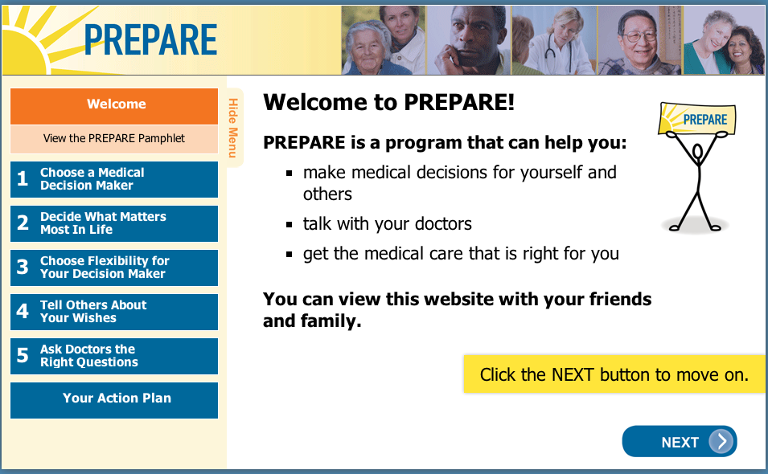
Decision Aids
This Photo by Unknown Author is licensed under CC BY-SA
Notes:
Quick mention of growing number of online decision aides. One example is Prepareforyourcare.org that is focused on walking older adults through the steps involved in advance care planning. It is available in several languages.

Slide 17
Takeaways
What is one element of ACP you learned today that you want to apply to your practice moving forward?
This Photo by Unknown Author is licensed under CC BY
Notes:
5 MINUTES
Depending on amount of time available, have a few learners share their responses OR go around in a circle and ask everyone to share
what they are taking away from the module today.

Slide 18
Questions? Thank you!
This Photo by Unknown Author is licensed under CC BY-NC-ND
Notes:
Take a few minutes for questions/concerns/observations

Slide 19
References
Sharp T, Moran E, Kuhn I, Barclay S. Do the elderly have a voice? Advance care planning discussions with frail and older individuals: a systematic literature review and narrative synthesis. Br J Gen Pract. 2013;63(615):e657-e668.
Sudore RL, Heyland DK, Lum HD, et al. Outcomes That Define Successful Advance Care Planning: A Delphi Panel Consensus. J Pain Symptom Manage. 2018;55(2):245-255.e8.
McMahan RD, Knight SJ, Fried TR, Sudore RL. Advance care planning beyond advance directives: perspectives from patients and surrogates. J Pain Symptom Manage. 2013;46(3):355-365.

