Slide 1
Primary Palliative Care Education Symptom Management
Notes:
SLIDES 1-2: 2 MINUTES

Slide 2
Objectives
Appreciate the frequency with which seriously ill patients experience symptoms.
Demonstrate a holistic approach to symptom management.
Identify key assessment and management strategies for three of the most common symptoms.

Slide 3
For Reflection What symptoms do your patients face that are most challenging to their quality of life and/or cause suffering?
Notes:
5 MINUTES

Slide 4
Guiding Principles and Practices
A thorough whole-person assessment is critical to effective symptom management.
High quality symptom management = High-touch, requires frequent follow-up and tinkering.
Combine pharmacologic and non-pharmacologic approaches to maximize impact.
Set realistic goals and expectations with patients and families.
Notes:
SLIDES 4-10: 18 MINUTES
An example of whole-person assessment is for shortness of breath- not only what is causing shortness of breath, but patients fears and reactions to it, social supports, living situations (i.e. flights of stairs), past experiences caring for family members who “suffocated”
Realistic goals and expectations- an example is with pain management; what is patient hoping to achieve with better pain management? (especially in terms of function); And what is realistic (we may not be able to get pain to 0/10 but hopefully can help relieve pain enough to be more functional)

Slide 5
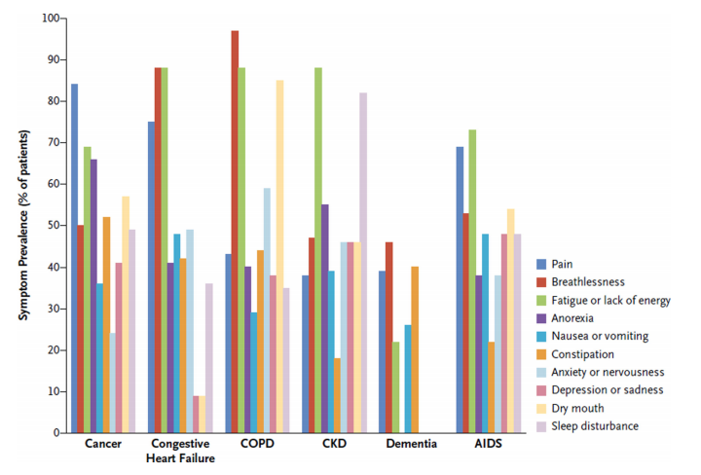
Symptom Prevalence
From The New England Journal of Medicine, Kelley AS, Morrison RS, Palliative Care for the Seriously Ill, 373, 747-755. Copyright © 2015 Massachusetts Medical Society. Reprinted with permission.
Notes:
This figure shows data are from representative studies of symptom prevalence among patients with serious illness.
Ask the group to consider what they notice
Consider highlighting:
Symptom prevalence relatively high across the board for all diseases, with the frequency of many symptoms being >50%
Not surprising, pain most common for cancer patients, but also high for patients with CHF
Nearly all cancer, CHF, CKD, COPD, and AIDS patients experience fatigue

Slide 6
Patient Engagement
Patient vs. Clinician Severity
Management Takes Time
Assessment Challenges
Language & Culture
Fear of Symptom Meaning
Clinician Knowledge & Routine Assessment
Changes Over Time
Challenges of
Symptom
Assessment
Clinician Knowledge & Routine Assessment
Notes:
For this slide, ask group what they find most challenging about symptom ASSESSMENT first then click to get suggestions onto slide
Highlight the assessment should span the bio-psycho-social-spiritual model whenever possible
Fear of what symptoms mean: no more chemo, disease progression, need for placement or hospitalization, “time for hospice”
Patient assessment may differ from clinician: Clinicians tend to rate symptoms lower than patients; caregivers tend to rate higher than patients (CITE)
Language and culture: word “fatigue” only found in English and French
Challenges with symptom assessment: i.e. communication - dementia, intubated patient, patients aren’t able to articulate symptoms; prioritization of pain above all other symptoms; multifactorial nature of symptoms

Slide 7
Symptom Assessment
OPQRST Mnemonic
Symptom severity and change over time; impact on function
Validated tools i.e. Edmonton Symptom Assessment Scale (ESAS)
Notes:
OPQRST: Onset, Palliating and Provoking factors, Quality, Response to previous treatments, Related factors/symptoms, Severity, and Temporality (the OPQRST historical structure for evaluating medical complaints
Symptom Severity: 0-10 scale OK
Be aware of the tools/language being used in your institution

Slide 8
Symptom Assessment (continued)
Useful questions:
Of the symptoms that have been bothering you, which symptom bothers you the most?
How do the symptoms affect you? How much do they interfere with your life? (e.g. Sleep? Daily activities? Your sense of well-being? Impact on family and roles?)
What are you most worried about? What are you hoping for?
Notes:
Patients may present with a plethora of symptoms. Asking which one is bothering them most may help you to prioritize how to tackle them in the time allotted.
The second set of questions is focused on function. Once you know the answers to these questions you can use them as targets to see if your symptom management plan is working (i.e. are they sleeping better? Are they now able to walk their dog? Are they less irritable? Etc.)
Simply asking the questions around what worries you most and what you are hoping for may be therapeutic in themselves. Exploring patients worries and fears may help you understand any underlying meaning they associate with their symptoms and facilitate a deeper conversation.

Slide 9
Symptom Management Tips
Physical
E.g., Cancer
Effusions
Drug toxicity
Patients’ reactions to symptoms occurs within a “constellation of experience”.
Consider the whole person
Approach with curiosity
Involve an interprofessional team and community-based resources
TOTAL
DYSPNEA
Social
E.g., Anxiety
Disappointment
Coping
E.g., Spouse
Children
Finances
Psychological
E.g., Meaning
Suffering
Spiritual
(Kamal 2011)
Notes:
Constellation of experience: For instance, a patient’s current reaction to shortness of breath is going to be influenced by their own past personal experiences with shortness of breath or other symptoms, other experiences (i.e. watching a family member “suffocate to death”, social and life stressors, support, trust from their care team, what the shortness of breath signifies etc…
For this reason important to consider the whole person including including their cultural, spiritual, social perspectives on symptoms, approach symptom assessment/management with curiosity, and involve your team and other resources when able
If helpful you can provide following example of how an interprofessional approach can contribute to enhanced sx management ---
50 yo man with metastatic lung cancer who reports dyspnea due to a large pleural effusion and underlying tumor
Medical/nursing: recommend thoracentesis, consideration of opioids and other non-medication based treatments (i.e. cool air, fan, pacing), consideration of positioning, breathing techniques, anctipatory guidance
Social work: ensuring adequate care structure to maximize function and safety given dyspnea; exploring fears related to dyspnea and past experiences, relaxation and mindfulness
Spiritual: exploring patient beliefs around suffering (i.e. avoiding morphine as it is necessary to suffer to go to Afterlife)

Slide 10
Symptom Management Tips (continued)
“Easier to stay ahead of [symptom] than catch up”
It’s often about the way the medication is used, not the medication you choose
Set expectations and follow-up/tinker frequently
Notes:
Example for “easier to stay ahead…”: Once you are nauseous there is often no turning back. Best to try to prevent it with multifactorial approach and when needed, scheduled anti-emetics
Example for ”its often about the way the medication is used..”: For patients with normal renal function, 2700 mg per day is typical effective dose of gabapentin for neuropathic pain treatment but patients/clinicians will stop trial of med at much lower doses claiming “it didn’t work” at 300 qhs, or even lower.
Example for ”setting expectations”: if first suggestion doesn’t work, there will be follow-up and we can try other things

Slide 11
Exercise: Symptom Break-Out Session
Symptom | Assessment | Management
Dyspnea
Fatigue
Nausea/ Vomiting
Notes:
EXERCISE: 25 MINUTES
Depending on the learner make-up of your group (i.e. disciplines), you can set the stage for this session with one of the cases below or brainstorm another one that best fits the specialty/interest of the group:
78 yo man with NHYA Class 3 Congestive Heart Failure reporting dyspnea with walking as well as nausea, and fatigue.
50 yo woman with advanced ALS c/b feeding dependence with PEG reporting worsening dyspnea, nausea, and fatigue
65 yo man with metastatic colon cancer to lungs and liver reporting dyspnea, nausea, and fatigue.
Handout out a copy of “Blank Symptom Assessment/Management Handout” to each learner.
Have learners break into groups of 3-4 and complete Symptom worksheet for the case. You can encourage them to look up the symptom they are working on at the mypcnow website if they get stuck or want more information to help fill out their chart. Allow 10 min for this small group breakout.
Come back together as a large group for 15 minutes. Depending on size of large group, ask each small group to report out on 1-2 categories (i.e. dyspnea assessment AND management).
You can refer to the included facilitator key (see document entitled ”Complete Symptom Assessment/Management Handout”) for teaching points.
If time remains during this session you can ask the group for questions about patients for whom they are currently struggling to manage symptoms.

Slide 12
Takeaways
What is one thing you learned today regarding symptom management that you hope to apply to your practice moving forward?
This Photo by Unknown Author is licensed under CC BY
Notes:
5 MINUTES
Depending on amount of time available, have a few learners share their responses OR go around in a circle and ask everyone to share
what they are taking away from the module today.

Slide 13
Questions? Thank you!
This Photo by Unknown Author is licensed under CC BY-NC-ND
Notes:
Take a few minutes for questions/concerns/observations

Slide 14
References
Kamal AH, Maguire JM, Wheeler JL, Currow DC, Abernethy AP. Dyspnea review for the palliative care professional: assessment, burdens, and etiologies. J Palliat Med. 2011;14(10):1167-1172.

