Slide 1
Primary Palliative Care Education Pain Management
Notes:
SLIDES 1-2: 2 MINUTES

Slide 2
Module Objectives
Discuss how a patient’s biologic/psychosocial/spiritual/cultural identity informs their experience of pain.
Identify helpful pain assessment tools and strategies.
Describe a multi-modal approach to managing pain.

Slide 3
For Reflection What have you found most challenging about managing seriously ill patients in pain?
Notes:
5 MINUTES

Slide 4
For Reflection What pain management techniques/strategies have you found work particularly well?
Notes:
5 MINUTES
Write down responses to be referred to as you progress through the rest of the module.

Slide 5
Guiding Principles and Practices
Pain is a physical, psychological, spiritual, emotional, cultural, and social phenomenon.
Comprehensive pain assessment is key.
Numerous disciplines play roles in optimal pain assessment and management.
Notes:
SLIDES 5-19: 18 MINUTES

Slide 6
“Suffering is not only caused by physical symptoms, but also spiritual, psychological, and social factors. A person's entire being can be affected by a serious illness and to treat pain effectively one must treat the whole person.”
Dame Cicely Saunders
Notes:
This is a very good description of “total pain” which encompasses not only physical pain but all the other factors that influence a patient’s experience of pain.

Slide 7
Bio-Psycho-Social+ Model
Biological
Psychological
Social
Spiritual
Cultural
(Sulmasy 2002)
Notes:
Illustration of holistic model of total pain and overlapping domains
Speaks to the importance of comprehensive pain assessment that includes more than the physical aspect of pain
Highlight challenge of differentiating one type of pain from another, noting overlap and how they impact/influence each other
Give example (or ask group to provide example from their clinical experience)
eg how anxiety about diagnosis can impact pain intensity
eg religious belief that suffering is important to achieving the afterlife
eg patient with pain whose child died of an opioid overdose, leading to reluctance to take opioids

Slide 8
Interprofessional Roles in Pain Management
Medical: Etiology of pain, medication/intervention plan and prescribing, education/counseling
Social Work: Access (insurance, finances, location), psychological relationship to pain and medications, changing social roles
Spiritual Care Services: Spiritual/existential pain, moral/ethical, mind-body-consciousness, religious understanding of medication/suffering
Patient Care Attendants: Ensuring safety, attending to toileting, bathing, repositioning
Rehabilitation Specialists: Maintaining function and adaptations
Notes:
Each discipline/team member brings skills and perspective that is valuable in pain management
Pose questions to the learners: “What do you see as your role in assessing and managing pain? What other disciplines play a role in assessment and management of pain?”

Slide 9
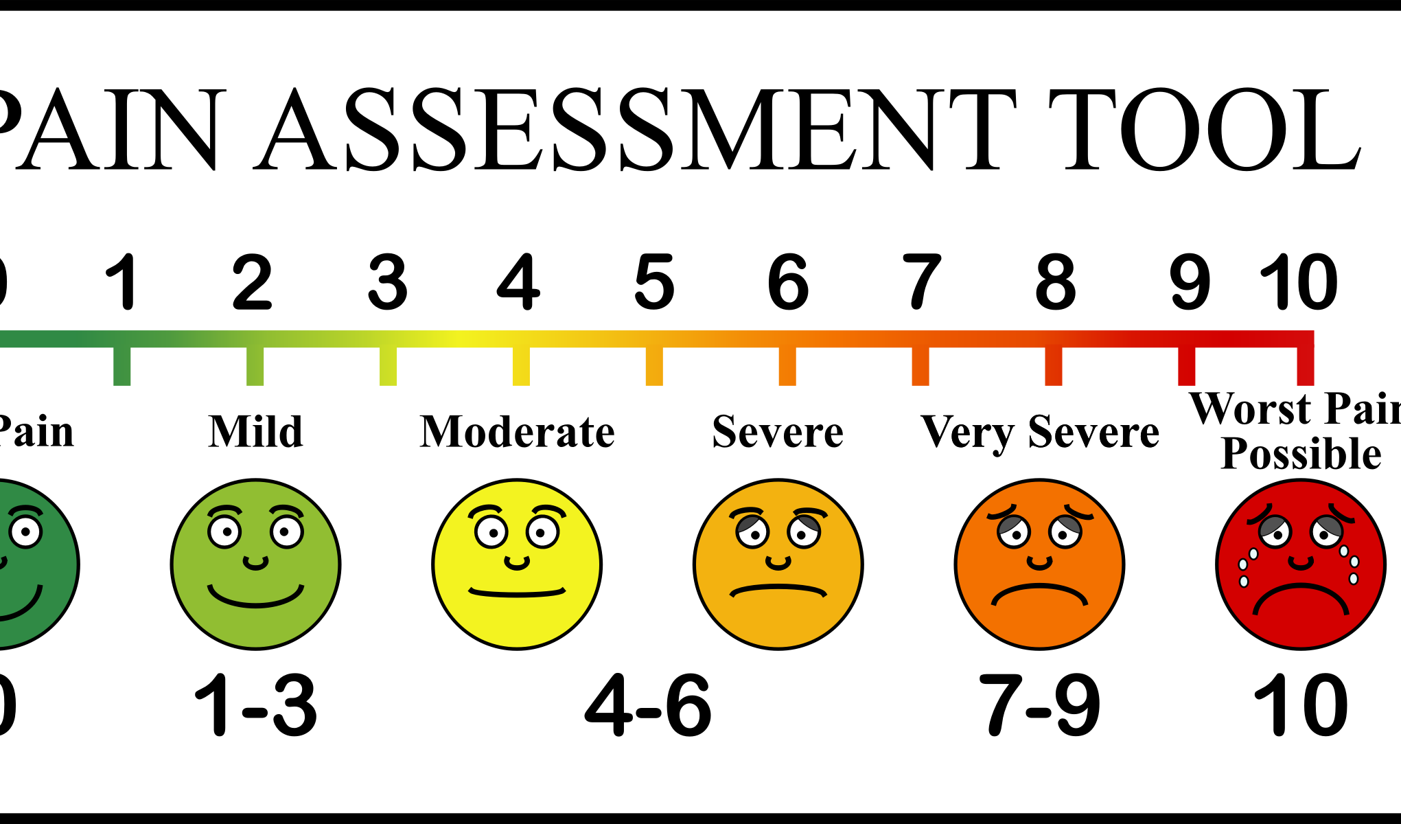
Pain Assessment
“How much pain do you have now?”
Pain scales
0–10 rating scale
Verbal descriptor scales
Pain thermometers
FACES pain scales
Same scale on repeat assessments
This Photo by Unknown Author is licensed under CC BY-SA-NC
Notes:
Gold standard = patient’s report
Use assessment scale that patient can relate to

Slide 10
Pain Assessment (continued)
Onset
Palliative or precipitating Factors
Quality of Pain
Region or radiation of pain
Severity
Temporal nature
Focus on function: How does pain impact your patient’s life?
Observational signs of distress
Facial expressions
Vocalizations
Body movements
Activity patterns
Mental status
Interpersonal interactions
Notes:
OPQRST– standard assessment questions
Plus: “how does pain impact patient’s life and function?”
Ask: “how are you coping with the pain?”
Observe for signs of distress in their:
facial expressions,
vocalizations,
body movements,
interpersonal interactions,
activity patterns, and
mental status

Slide 11
Characterizing Pain
Etiology
Chronicity
Type
Neuropathic
Inflammatory
Cancer
Acute
Nociceptive - somatic, visceral
Chronic
Acute on chronic
Chronic musculoskeletal
Other
Notes:
Highlight why this is important to characterize pain:
Impacts treatment plan
Understand the impact of pain on function, short and long term
Impact of pain given their life expectancy/trajectory of illness (aka is this pain going to get better?)

Slide 12
Management Categories
1. Communication
2. Disease-Modifying
3. Non-Pharmacological Therapies
4. Pharmacological Therapies
5. Interventional Pain Procedures
6. Education & Counseling
7. Ongoing Monitoring & Assessment
Notes:
Categories of interventions for pain management

Slide 13
Management Categories
1. Communication
“Relationship is a physiological process, as real and as potent as any pill or surgical procedure.”
A General Theory of Love, Lewis, Amini, Lannon, 2000
Notes:
Ask group to:
Reflect on the quote on the slide
How do you create space for patients and families to talk about pain? What types of questions do you ask?
Knowing the person is key: highlight need to understand relationship to Western medicines, relationship to opioids/sobriety, economic burden and access, ability to manage medications at home, etc

Slide 14
Management Categories
2. Disease Modifying Therapies
Can I fix or ameliorate the cause of this pain?
Radiation therapy
Chemotherapy
Surgery
Diuresis (i.e. for taut edema related to CHF)
Hydration, addressing electrolytes
Addressing co-morbid mood disorders (i.e. Depression or anxiety)
Notes:
Highlight:
Treatments on slide are just examples, list is not comprehensive.
Ideally, we always try to identify the underlying cause of the pain and address as directly as possible, if within goals of care.

Slide 15
3. Non-Pharmacological Therapies
Physical
heat & ice
physical therapy
physical activity
Psychological/Cognitive
education
biofeedback
hypnosis
Integrative Therapies
guided relaxation
healing touch/reiki
acupuncture
yoga
massage
compassionate listening
supportive counseling
cognitive behavioral interventions
guided imagery & visualization
meditation &mindfulness
expressive arts and music
Notes:
Relaxation training decreases pain, anxiety, and distress, and improves mood, sleep quality, and fatigue (Kwekkeboom et al. 2008 ; Lolak et al. 2008 ; Deng et al. 2009 ; Rabin et al. 2009 ; Yang et al. 2010 ; Chan et al. 2011 ).Ongoing relaxation practice produces a better effect than a brief relaxation experience (Deng et al. 2009 ) . Relaxation training is tolerated by cancer patients, even those with advanced disease (Demiralp et al. 2010 ; Adamsen et al. 2012 ) . As a whole, the evidence supporting the use of relaxation training with cancer patients is robust.
Guided imagery on cancer pain: three out of five studies included in the review showed that patients experienced a decrease in pain and pain-related distress (King 2010 ) .
Massage is recommended for the management of pain and/or anxiety, and there are indications that it may be useful for nausea prevention and management. (Deng et al. 2009)
Use of acupuncture is beneficial for adjunctive management of pain, as well as for poorly controlled nausea and vomiting, dyspnea, and xerostomia (Deng et al. 2009 ; Cassileth and Keefe 2010 ; Ernst 2011 )
In 2011, Li and colleagues (2011) conducted a RCT of the effectiveness of music therapy on pain in 120 mastectomy patients randomized into intervention and control groups. Pain ratings were significantly reduced in the intervention group after a twice a day 30 min music intervention.
Ross and Thomas ( 2010 ) found that yoga was superior to exercise in all outcome measures other than fitness. Symptoms in chronically ill patients found to be improved by yoga included fatigue, mood, pain, and QOL.

Slide 16
4. Pharmacological Therapies
A. Primary & Secondary Agents
Type of Pain | Opioids | Adjuvants
 |  | Neuropathic agents | NSAIDS | Steroids | Acetamin-ophen
Nociceptive | X |  | X |  | X
Neuropathic | X | X | ? |  | ?
Inflammation | X |  | X | X | X
Antidepressants Serotonin-norepinephrine reuptake inhibitors (SNRIs) Venlafaxine Duloxetine Tricyclics | Antiepileptics Gabapentin Prebabalin Carbamazepine Oxcarbazepine Topiramate Lamotrigine
B. Secondary & Tertiary Agents: Methadone, Ketamine
Notes:
Ask learners to provide examples of each type of pain
Discuss categories of medications to target each type of pain
Highlight use and importance of multimodal pharmacologic approach—opioids, NSAIDS, antidepressants, anticonvulsants, acetaminophen, steroids
If time allows, can mention potential role of medical cannabis here

Slide 17
5. Interventional Pain Procedures
Procedure | Indication
Peripheral Nerve Blocks (Upper and Lower Extremities) | Localized extremity pain
Epidural/paravertebral catheters | Sympathetic pain or visceral pain
Gasserian Ganglion Blocks, Spheno-Palatine Blocks | Trigeminal Neuralgia, Atypical Facial Pain
Occipital Nerve Blocks | Acute or acute on chronic headaches
Sympathetic Nerve Blocks | Visceral abdominal and pelvic pain
Epidural Steroid Injections or Facet Joint Injections | Acute or acute on chronic spinal pain
Sacro-Iliac Joint Injections | Sacroilitis
Major joints injections | Arthritis
Trigger point injections | Myofascial pain
Implantable Devices (Spinal Cord Stimulator, Intrathecal catheter pumps) | Refractory or intractable pain
Notes:
Included for completeness, review briefly.

Slide 18
Management Categories
6. Education & Counseling
Language: Opioids v. Narcotics
Etiology of pain
How medications work
How to take medications
Patient & family concerns
Adverse effects & management
Who to call for help
Misuse
Mind/body and psycho-spiritual connection
Notes:
Listening for emotional undertone, hesitancy and concerns that will impact treatment adherence and plan
Checking own biases….

Slide 19
Management Categories
7. Ongoing Assessment & Management
Focus on function: IADLs, ADLs, mood, sleep, ability to engage in joyful activities
Stop or do not escalate medications that are not helpful – including opioids
One change at a time
Balance multimodal analgesia w/polypharmacy & adverse effects
Opioids – monitoring for misuse
Supporting medication transitions
Notes:
Useful questions for patients with chronic pain: “What are you able to do taking the medication that you can’t do without?”
Emotional impact: “How are you coping with the pain?” “What worries or concerns do you have?”
Setting realistic expectations
Encouraging optimization of nonpharmacologic strategies, especially if pain is chronic

Slide 20
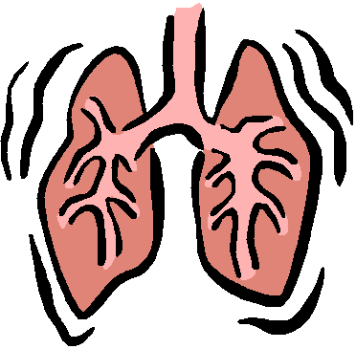
Case Discussion
78 y.o. female with COPD, osteoarthritis, and new diagnosis of lung cancer, invading pleura
Former smoker
Stopped drinking 12 years ago, in AA
Lives alone
Chronically takes hydrocodone/acetaminophen 10/325 TID
This Photo by Unknown Author is licensed under CC BY-SA-NC
Notes:
CASE DISCUSSION (SLIDES 20-22): 20 MINUTES TOTAL
Can use this case or ask learners to suggest a case from their clinical setting for discussion.
Can discuss as whole small group or divide into pairs to discuss for 5 min before returning to larger group.
Discussion questions are below and also on next slide (slide 22):
Potential causes of pain based on biopsychosocial model. What would you want to know or ask?
Indicated workup
How might you intervene to manage the pain? What interprofessional team members would you want to include in management?

Slide 21
Case Discussion
Potential causes of pain based on biopsychosocial model
Indicated workup
How might you intervene to manage the pain? What interprofessional team members would you want to include in management?

Slide 22
Takeaways
What aspect of the biopsychosocial+ model do you plan to focus on more intently the next time you assess a patient’s pain, and why?
This Photo by Unknown Author is licensed under CC BY
Notes:
5 MINUTES
Depending on amount of time available, have a few learners share their responses OR go around in a circle and ask everyone to share
what they are taking away from the module today.

Slide 23
Questions? Thank you!
This Photo by Unknown Author is licensed under CC BY-NC-ND
Notes:
Take a few minutes for questions/concerns/observations

Slide 24
References
Sulmasy DP. A biopsychosocial-spiritual model for the care of patients at the end of life. Gerontologist. 2002 Oct;42 Spec No 3:24-33.

