Slide 1
Primary Palliative Care Education Psychological and Social Care
Notes:
SLIDES 1-2: 2 MINUTES

Slide 2
Objectives
Appreciate how the psychological and social aspects of patients’ lives influence their experience of serious illness.
Learn simple screening methods to identify psychosocial needs.
Understand how to provide basic support and other resources to address these needs.
Notes:
When introducing the session, state that the module will provide a brief overview of psychological and social care. The focus of the module is on familiarizing and screening not treatment given the large scope of these topics.

Slide 3
For Reflection
What do you think you are doing well when it comes to assessing the psychological and social aspects of care for patients and families?
Where do you need to expand your knowledge and practice?
Social
Notes:
5 MINUTES
Facilitate a large group discussion regarding questions on slide. Facilitator could consider writing down on a whiteboard or large sheet of paper what areas participants have identified for further learning.

Slide 4
Guiding Principles & Practices
Informed by self-awareness
Requires the multiple perspectives of the intersectional and interprofessional lens
Focus on active listening and accompaniment
Evidence-based and research-informed
Integrated into plan of care
Notes:
SLIDES 4-15: 28 MINUTES
The principles on this slide form the foundation for the assessment of psychological and social need and subsequent management.

Slide 5
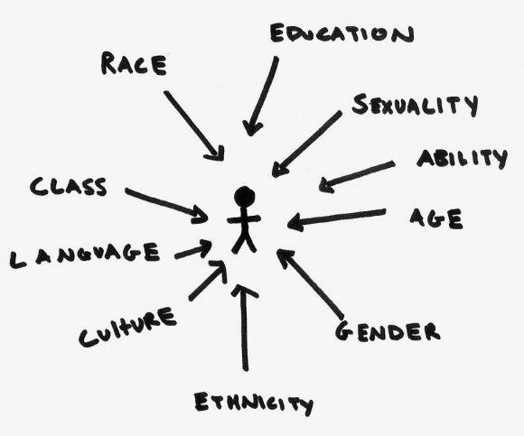
Intersectionality
This Photo by Unknown Author is licensed under CC BY
Notes:
Intersectionality refers to the interconnected nature of social categories such as race, class and gender, as they apply to an given individual or group, regarded as creating overlapping and interdependent human experience. Looks to understand the experience of systematic power, privilege, disadvantage and marginalization.

Slide 6
Case Introduction: Derek Tanaka
67-year-old Japanese man admitted to the hospital with severe lung problems
Newly diagnosed with squamous cell carcinoma
Previously living on the city streets and at his ex-wife’s house
History of clinical depression
Refusing recommended surgery
Notes:
Introduce Derek Tanaka - TELL a story about his life to engage learners
Highlight that none of these things are facts – need to learn what they mean to Derek
Give us information to fuel curiosity about who he is, what his world is like, values/beliefs, strengths and stressors
Link intersectionality from previous slide to Derek’s possible experience/attitudes/behaviors towards serious illness: man, middle-aged, marginally housed, Japanese

Slide 7
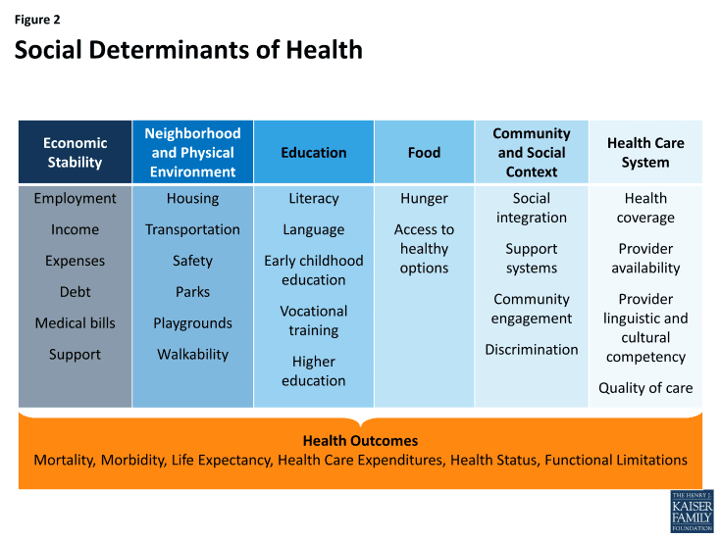
Social Determinants of Health
This Photo by Unknown Author is licensed under CC BY-ND
Notes:
Intersectional experience links to the social determinants of health
The social determinants of health are the conditions in which people are born, grow, work and age. These circumstances are shaped by the distribution of money .power and resources at global, national and local levels (WHO)
This is why you need to be able to screen for psycho social spiritual and cultural dimensions of personal/family experience – they link to health care outcomes
Pull out a few to elaborate on them and how they influence the experience of serious illness. Housing… for example

Slide 8
What We Want to Understand
What is most important to you right now?
Initial assessment involves a short screen to identify strengths and stressors
Validate and affirm strengths
Identify urgent need/distress
Referrals to specialized provider for in-depth assessment
Linkage to community resources
Notes:
Guidelines for screening for psychological needs, strengths and stressors. Important to know who to refer to others and community resources if there is need and what each clinician is responsible for in their screening. Participants may need exact language, a few sentences to elucidate the information.

Slide 9
Psychological Screen:
What are you curious about?
This Photo by Unknown Author is licensed under CC BY
Notes:
Pose the question to the group: When you are wanting to learn more about your patient’s psychological health and concerns, what do you aim to understand?
Possible learner responses include, but are not limited to: Emotional distress, anxiety, depression, coping strategies, delirium or dementia, learning or developmental disabilities, decisional capacity, history/presence of substance use disorder, History/presence of suicidality, current or previous trauma, dual diagnosis

Slide 10
Psychological Aspects of Care
Notes:
Mental status: what is the current mentation? Are they alert and oriented enough to engage in screening and assessment. Do they have situational decisional capacity?
Mood: Differentiate between a normal and appropriate reaction to serious illness and dying versus a more serious psychiatric disorder such as major clinical depression.
Trauma: It's important for palliative care providers to know that a serious medical illness is itself a well-known cause of serious trauma and post-traumatic stress disorder in addition to pre-existing traumatic experiences that a patient or caregivers may be facing.
Stress & Adjustment: For most patients in palliative care, symptoms of stress are normal and are expected consequences given the uncertainties and loss of control of living with serious illness and the possibility of approaching death. It is helpful to be aware of process of adjustment and basic understanding of adjustment disorder.
Substance Abuse: Importance of differentiating symptom management needs with previous substance use. Balancing pain treatment with risks of comorbid substance use disorder for patients with serious illness.
Anticipatory Grief: Feelings of grief that occur before impending loss or in response to multiple series of losses, can be related to a impending death or other losses.
Demoralization: Situational hopelessness and helplessness due to a sense of loss of identity, purpose and meaning.
Non-Ordinary States: Altered states of consciousness, include various mental states in which the mind can be aware but is not in its usual wakeful condition, such as during hypnosis, meditation, hallucination.
Bereavement: The period after a loss during which grief is experienced and mourning occurs.

Slide 11
Psychological Screening
How do you feel you are coping with everything that is going on?
How is your mood?
Are you depressed?
Have you lost interest or pleasure recently?
What gives you strength?
Notes:
A place to start screening. All team members can be trained to screen for psychological need and refer for assessment and care. Referral can be to a trained social worker, therapist or psychologist.

Slide 12
Social Screen:
What are you curious about?
This Photo by Unknown Author is licensed under CC BY
Notes:
Pose the question to the group: When you are wanting to learn more about your patient’s psychological health and concerns, what do you aim to understand?
Possible learner responses include, but are not limited to: Emotional distress, anxiety, depression, coping strategies, delirium or dementia, learning or developmental disabilities, decisional capacity, history/presence of substance use disorder, History/presence of suicidality, current or previous trauma, dual diagnosis

Slide 13
Social Aspects of Palliative Care
Notes:
Could ask the group: How might these areas influence the experience of serious illness, decision-making and overall well-being?

Slide 14
Social Screening
How has this illness impacted your daily life?
How are things at home?
How are your relationships?
What are your practical concerns?
Notes:
A place to start screening. All team members can be trained to screen for social need and strengths and refer for assessment and care.

Slide 15
Case Discussion: Derek Tanaka
67-year-old Japanese man admitted to the hospital with severe lung problems
Newly diagnosed with squamous cell carcinoma
Previously living on the city streets and at his ex-wife’s house
History of clinical depression
Refusing recommended surgery
Notes:
15 MINUTES
Reintroduce the Derek Tanaka case
Review screening and referral using the tools discussed in the previous slides on psychological and social screening.
Can ask the learners: “What would you be curious about?”; “How would you collaborate on getting Derek and his family/caregivers support?”

Slide 16
What to do with screened information?
Listen and accompany (witness)
Validate and affirm strengths
Screen for urgent need
Address if within your expertise
Include information for plan of care
Refer for further assessment and care
Build awareness of institutional and community resources
Notes:
SLIDES 17-20: 5 MINUTES
Sometimes team members forgo screening because they do not know what to do with the information or have limited community resources. This section invites learners to screen for needs and think about resources.

Slide 17
Takeaways
Every aspect of a person’s life influences their experience of serious illness.
All providers participate in identifying strengths and stressors.
Screening takes practice and experimentation.
Being with people through active listening and accompaniment is often the most important intervention.
This Photo by Unknown Author is licensed under CC BY
Notes:
Depending on amount of time available, have a few learners share their responses OR go around in a circle and ask everyone to share
what they are taking away from the module today.

Slide 18
Questions? Thank you!
This Photo by Unknown Author is licensed under CC BY-NC
Notes:
Take a few minutes for questions/concerns/observations

Slide 19
References
Cagle, J., Weathering the Storm: Palliative Care and Elderly Homeless Persons, Journal of Housing For the Elderly, 2009; 23:1-2, 29-46.
Lloyd-Williams, M, Shiels, C, Taylor, F., Dennis, M. Depression — an independent predictor of early death in patients with advanced cancer. J Affect Disord, 113 2009; pp. 127-132.
Lloyd-Williams, M, Cobb M, O’Connor C, et al. A pilot randomised controlled trial to reduce suffering and emotional distress in patients with advanced cancer. J Affect Disord 2013; 148(1): 141–145.
Mitchell, AJ, Chan, M, Bhatti, H. Prevalence of depression, anxiety, and adjustment disorder in oncological, haematological, and palliative-care settings: a meta-analysis of 94 interview-based studies. Lancet Oncol. 2011;12(2):160–174.
Rodin G., Research on psychological and social factors in palliative care: an invited commentary. Palliat Med. 2013; Dec;27(10):925-31.
Song, J., Wall, M., Ratner, E., Barteis, D., Ulvestad, N., and Gelberg, L. Engaging homeless persons in end-of-life preparations. Journal of General Medicine, 2003; 23(12), 2031–2045.
Stajduhar, K.I., Mollison, A., Giesbrecht, M. et al. “Just too busy living in the moment and surviving”: barriers to accessing health care for structurally vulnerable populations at end-of-life. BMC Palliat Care. 2019; 18, 11.

